Slide 1

Pneumonia Detection
Pneumonia detection using real time CNN models.

Slide 2
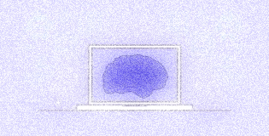
Problem Statement
Pneumonia is a respiratory infection caused by bacteria or viruses. Early diagnosis of pneumonia is crucial to ensure curative treatment and increase survival rates.
Chest X-ray imaging is the most frequently used method for diagnosing pneumonia. However, the examination of chest X-rays is a challenging task and is prone to subjective variability.
Our Pneumonia detection model provides maximum efficiency and accuracy. It helps to considerably reduce the time it takes to detect the disease.

Slide 3
Overview
Pneumonia detection is commonly predicted using basic CNN models. However , the accuracy of these state of the art models is pretty low. On the other hand, our approach of using Transfer learning, that is, by using VGG-19 and ResNet50, we can get a much better accuracy.
Our project consists of 3 approaches:
VGG-19 Model
ResNet50 Model
ResNet50 Model after Fine-Tuning parameters

Slide 4

Prerequisites
Tensorflow
Keras
Python 3
VSCode
Google Colab
Numpy
Matplotlib
Pandas
Seaborn

Slide 5
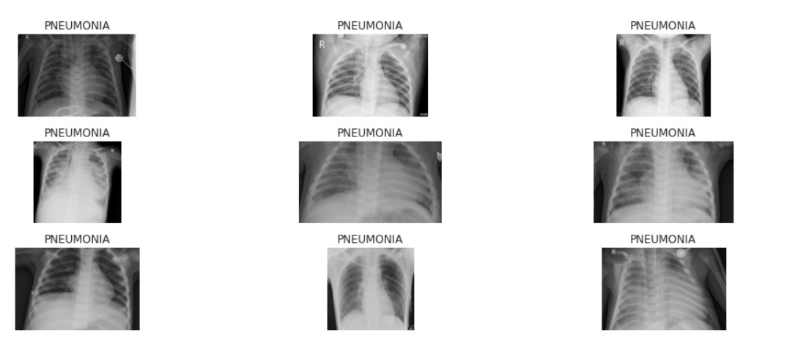
Diseased chest Xray images

Slide 6
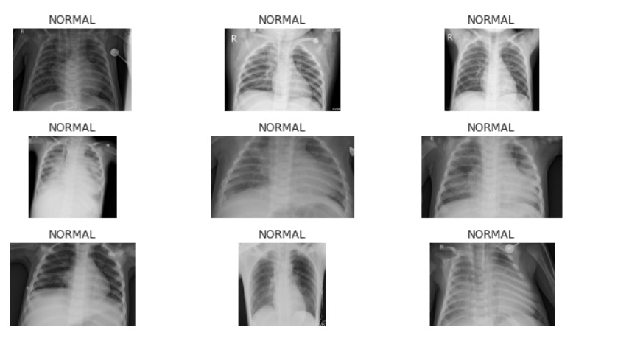
Normal chest Xray images

Slide 7
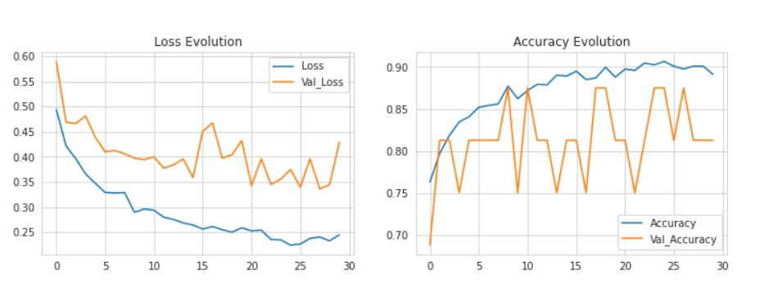
Performance of VGG-19

Slide 8
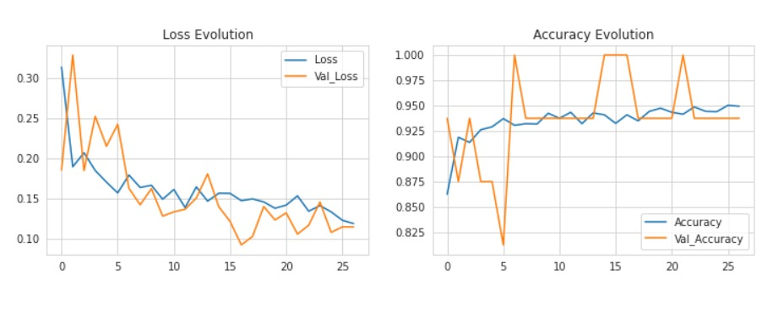
Performance of ResNet50

Slide 9
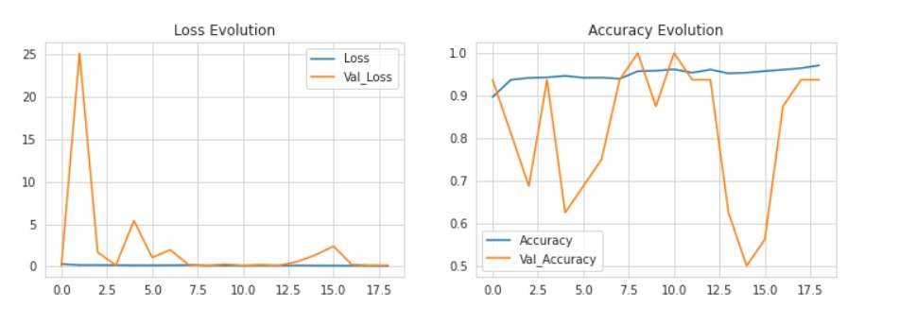
Performance of ResNet50 after fine tuning

Slide 10
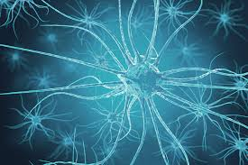
Societal Benefit
Pneumonia detection model will help in considerably reducing the time it takes to diagnose someone with the disease with at most accuracy.
Since time is of sheer importance for pneumonia treatment, the model can be a life saving amenity.
Future advancements on the model could be of a website where people can upload their scans for diagnose thus reducing the monetary toll.

Slide 11

Team Details
Rishikesh S. (RA1911003010720)
Ananya Negi (RA1911003010722)
Yash Kesarwani (RA1911003010727)

